Slide 1
Speed Dating Analysis
By:
Onyinye Ihedoro
Sai Gaddipati
Esha Somavarapu

Slide 2
Introduction
The Speed Dating Experiment contains data generated from a series of experimental dating events which involve 4-minute interactions with the opposite sex.
Data is related to age, gender, habits, desired attributes in form of a questionnaire in different parts.

Slide 3
Data Exploration Ideas
What are the largest age groups that have participated in the experiment?
Different Demographics? Education/Career Background?
Which race is more attractive to females?
Desirable attributes based on Gender?
Different age groups interested in dating people their own race?
Does income play a role in being attracted to the opposite sex?

Slide 4
Data Preparation
Converted the .csv dataset to a UTF-8 encoding in order to import in python
Observed the variables to determine relevant variables for visualization
Deleted the missing values from our dataset in order to produce better results
Exported newly created dataset as CSV and connected to Tableau Dashboard

Slide 5
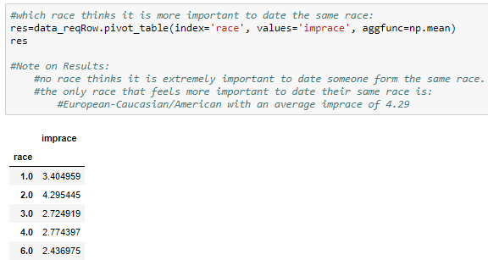
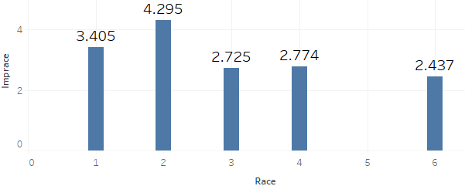

Race as a factor of selecting a partner.
How important is it for someone to date a person from their own race?

Slide 6
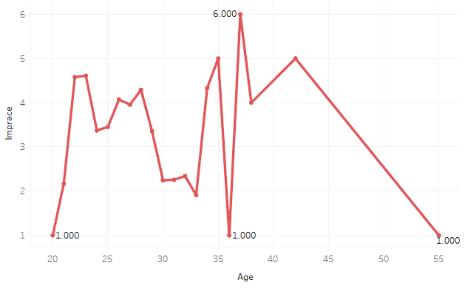
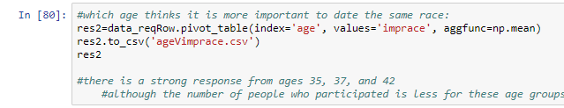
The effect of Age on Race importance
The number of participants with age beyond 30 are very less when compared to ages before 30.
People are a little concerned about the race of their partner about 40% of the time but they are not afraid to explore a little.

Slide 7
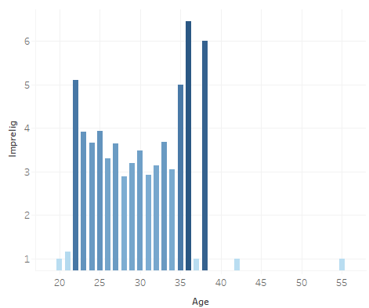

Age vs Importance of Religion
From the graph it is evident that the importance of religion increases after the age of 35.
There is an outlier at the age 36 that has some sort of disturbance in every graph.
This graph is similar to importance of same race Vs. age as seen earlier but religion seems to be of a bit more importance when it comes to relationships.
People are religious in their earlier stages of life and in the end but not in their late 20’s and early 30’s. (Probably adventure time)

Slide 8
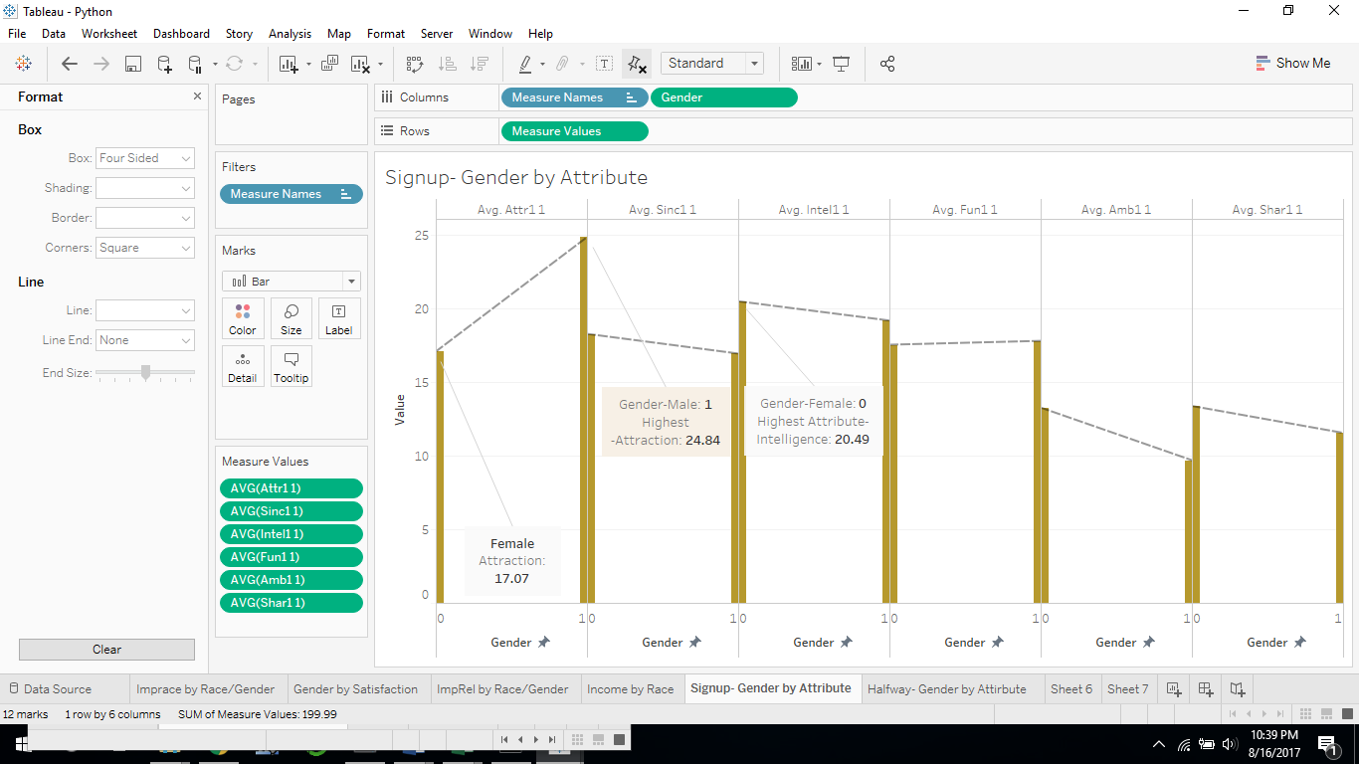
Signup- Highest Desirable Attribute by Gender
Using trend lines and annotations.
0 = Female
1 = Male
Attr1_1 = Attraction
Amb1_1 = Ambition
Fun1_1 = Fun
Intel1_1 = Intelligent
Sinc1_1 = Sincere
Shar1_1 = Shared Interests
Highest Attributes-
Male-Attraction
Female-Intelligence

Slide 9
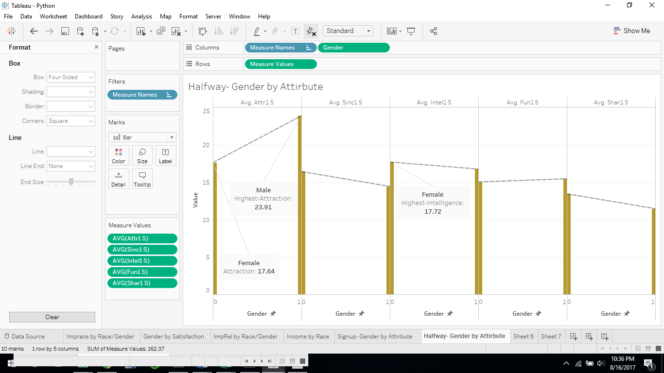
Halfway- Highest Desirable Attribute by Gender
Using trend lines and annotations.
0 = Female
1 = Male
Attr1_1 = Attraction
Amb1_1 = Ambition
Fun1_1 = Fun
Intel1_1 = Intelligent
Sinc1_1 = Sincere
Shar1_1 = Shared Interests
Dip in Female Intelligence, and Increase in Attraction

Slide 10
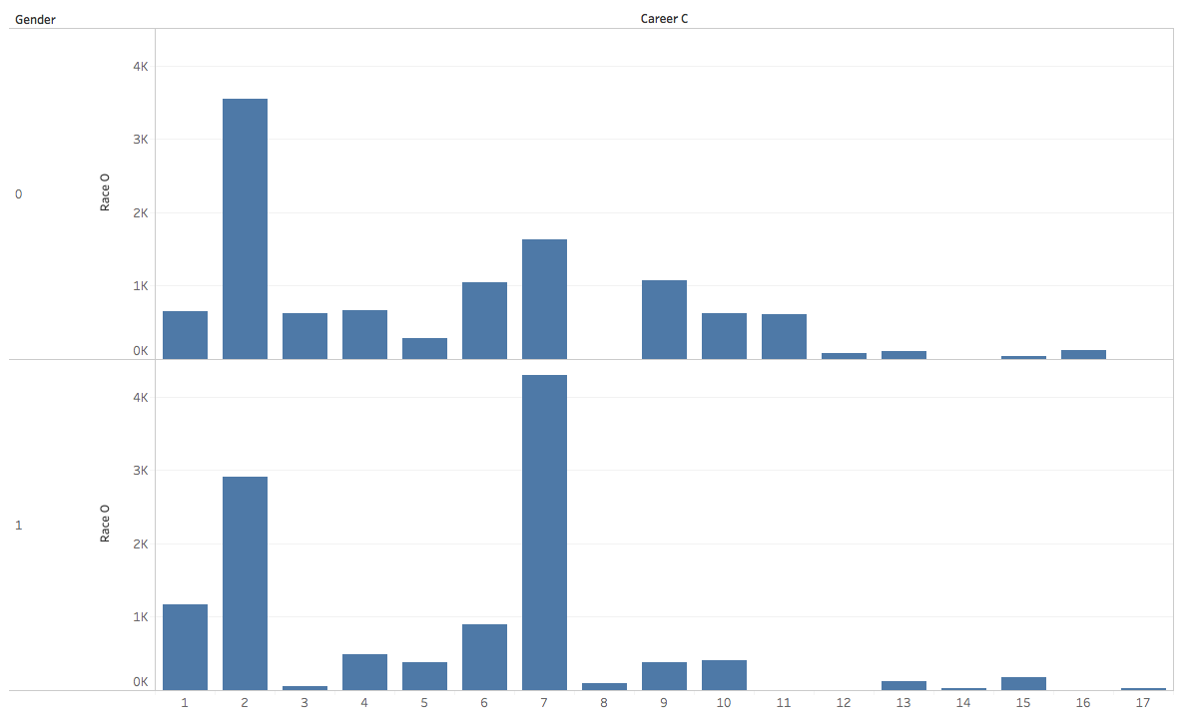
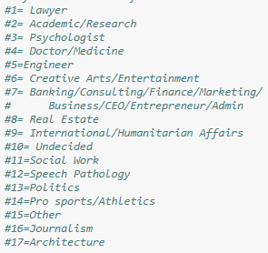
Results
Race 0 = Female
Race 1 = Male
Partner’s Career by Gender

Slide 11
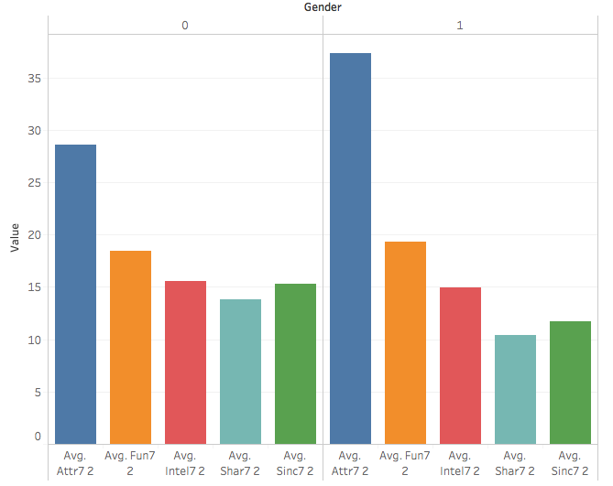
Results
0 = Female
1 = Male
Desired Attributes by Gender
Attr7_2 = Attraction
Amb7_2 = Ambition
Fun7_2 = Fun
Intel7_2 = Intelligent
Sinc7_2 = Sincere
Shar7_2 = Shared Interests

Slide 12
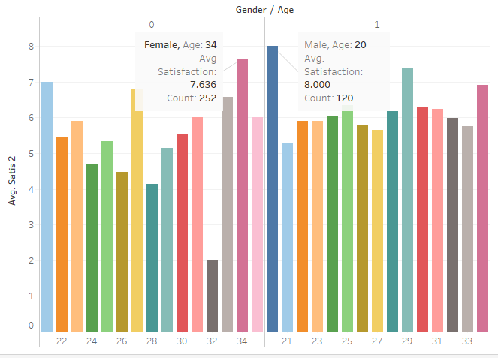
Satisfaction by Age/Gender
Women aged 34 are more satisfied
Overall, men aged 20 are more satisfied with the speed date

Slide 13
Conclusion
On signup, the male participants’ desired attribute is attractiveness to females, and for females it is intelligence. Men are more interested in attractive women, not those with shared interests
Halfway through, there is a slight dip in Male preference in attraction, and women have an increase in Attraction attribute
The final survey shows that in Males the attraction remains the same while a dip in intelligence and preferring women who are more fun. In Females there are a lot of changes with increase in requirement for attractiveness, increase in fun and a dip in ambitiousness.
At the end of the survey, 20 year old males and 34 year old females were more satisfied with the outcome of the speed date. This shows it would probably be advantageous to target individuals within those age ranges.

